Slide 1
COMPUTER VISION-BASED ATTENDANCE TRACKING SYSTEM WITH VOICE FEEDBACK
Batch no: A7
Date: 23.05.2023
Guided by
Dr Salma Fauzia, Assistant Prof, ECED
Presented by
Mohammed Irfan Ali (1604-19-735-015)
Mohammed Abdul Shoaib (1604-19-735-019)
Mohamed Sadiq Uddin (1604-19-735-030)

Slide 2
Overview
Introduction
Design Objective
Design Methodology
Design specification
Applications
Literature survey
Hardware Design
Facial Recognition Methodology
Software Implementation
Web Development
Conclusion
References

Slide 3
Introduction
The project is a facial recognition-based attendance system using the Raspberry Pi 4B, which is designed to capture the attendance of students in a classroom setting using facial recognition technology.
The system uses a camera to capture the image of a student's face and then identifies the student using facial recognition algorithms.The system then stores the attendance data in a database, which can be accessed and used for record-keeping purposes.
The system provides a user-friendly interface for the teacher to view attendance records and generate reports.
The text-to-speech feature provides an additional layer of accessibility for visually impaired users.
The project's implementation is expected to provide benefits such as reducing the workload of teachers in taking attendance manually, improving attendance management accuracy, and reducing the potential for attendance fraud.

Slide 4
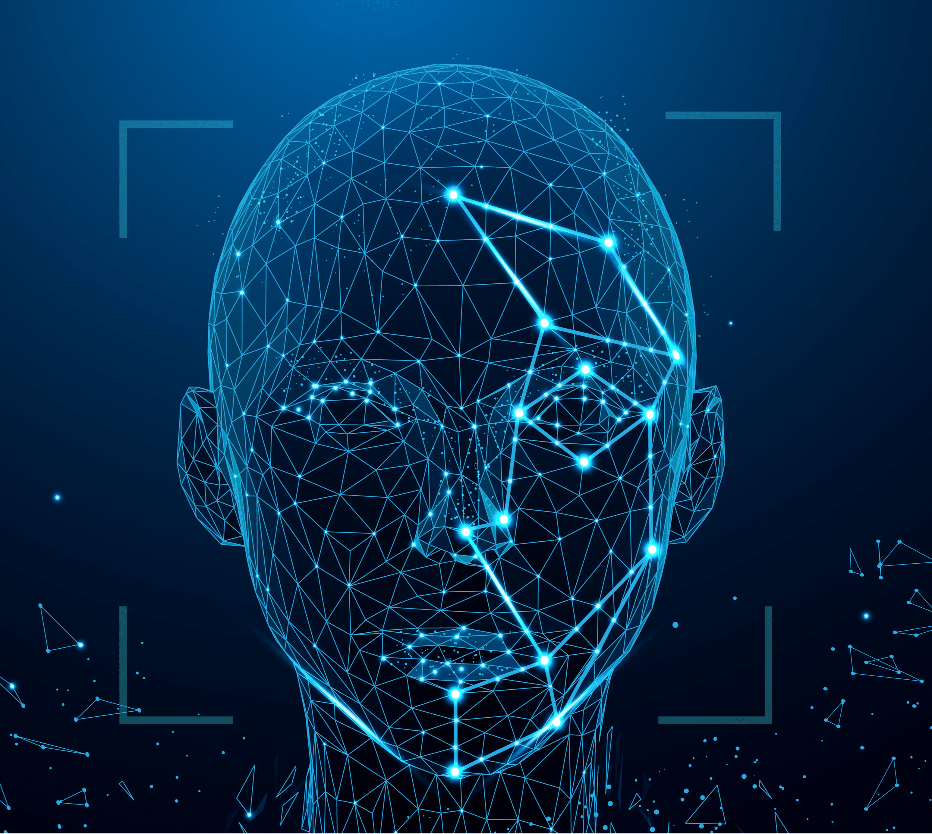
APPLICATIONS
Reduces the workload of teachers in taking attendance manually
Improves attendance management accuracy
Reduces the potential for attendance fraud.
Provides Data Visualisation of attendance
The system ensures the accuracy and reliability of attendance records by utilizing facial recognition technology.

Slide 5
IDENTIFICATION OF PROBLEM
Manual attendance taking in educational institutions is often inefficient, prone to errors, and time-consuming.
To address this challenge, we have developed a facial recognition-based attendance system that automates the process, saving time and resources while ensuring the accuracy and safety of attendance records.

Slide 6
Literature Survey
S.NO | TITLE | AUTHOR | ABOUT THE PAPER
1. | [1] An Automatic Attendance System utilizing Image Processing Techniques | Ahmedi and Nandyal | Their system aims to accurately recognize and track individuals through sophisticated image analysis, thereby offering an efficient and reliable solution for attendance management.
2. | [2] Real-time Computer vision algorithms for Automatic Attendance management systems | Shehu and Dika | Their research delved into the application of computer vision techniques in capturing and processing attendance data in real-time, which aligns closely with the project's objective of real-time attendance tracking.

Slide 7
3. | [3] An Automatic Attendance management system based on face recognition | Joseph and Zacharia | Their approach centers on leveraging face recognition algorithms to accurately identify individuals and record attendance data, providing a foundation for the project's core concept.
4. | [4] A smart Attendance system that utilizes face recognition coupled with a percentage analyzer | Kanti and Papola | Their system employs face recognition techniques and advanced analysis to calculate attendance percentages for individual students, which aligns with the project's aim to provide comprehensive attendance monitoring capabilities.

Slide 8
5. | [5] Application of Artificial Neural Networks for face recognition | Le | This study investigates the efficacy of neural networks in recognizing and identifying individuals based on facial features, providing valuable insights into potential approaches for the project's face recognition algorithm.
6. | [6] Attendance management system based on face recognition using Matlab and Raspberry Pi 2 | Mehta | This system incorporates image processing techniques and leverages the capabilities of Raspberry Pi for real-time attendance tracking, which is directly applicable to the project's utilization of the Raspberry Pi 4B.

Slide 9
Design Objective
To provide a robust attendance system for educational institutions that can significantly reduce the manual workload and enhance the efficiency of the attendance taking process.
To develop a facial recognition-based attendance system
To ensure data security and privacy
To provide a user-friendly web interface for attendance management

Slide 10
Design Methodology
Requirement Analysis
Data Collection
Facial Recognition Model Training
System Architecture Design
Image Acquisition and Preprocessing
Facial Recognition and Attendance Tracking
Voice Feedback Integration
User Interface and Interaction

Slide 11
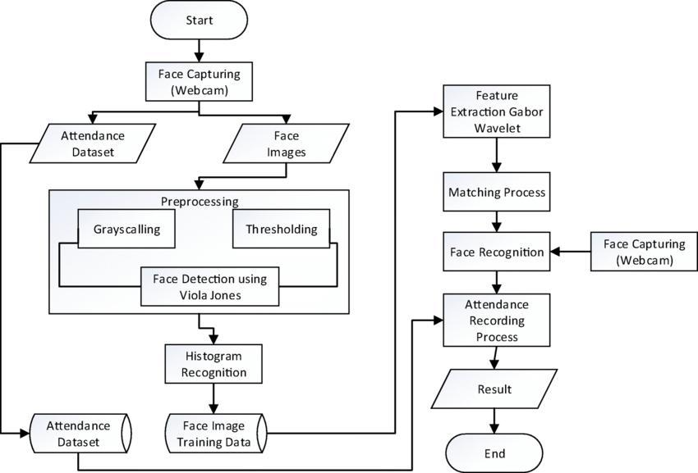
Design Specification

Slide 12
HARDWARE DESIGN
Components used:
Webcam
Raspberry Pi 4B
3D Printed Face Mask
OLED Display
Arduino

Slide 13
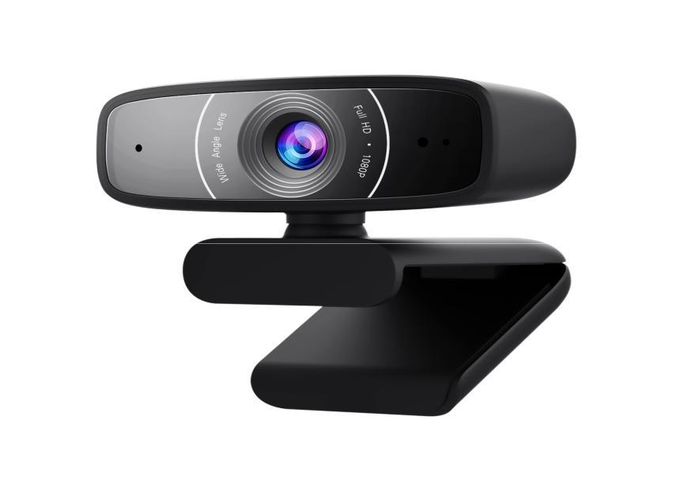
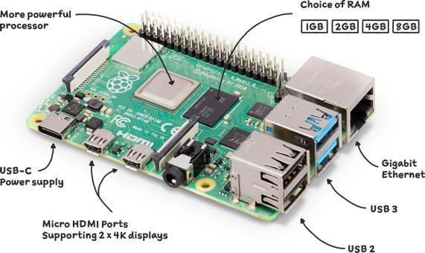
WEBCAM
RASPERRY PI 4B
The webcam plays a crucial role in capturing images and videos of students for facial recognition and attendance tracking. The webcam captures images of the students' faces, which are then processed by the facial recognition algorithm to identify them.
The Raspberry Pi 4B is used to control the system's hardware components, including the webcam and OLED display on the face mask. It also runs the facial recognition algorithm, which compares the captured images to the images stored in the system's database to identify the students and record their attendance.

Slide 14

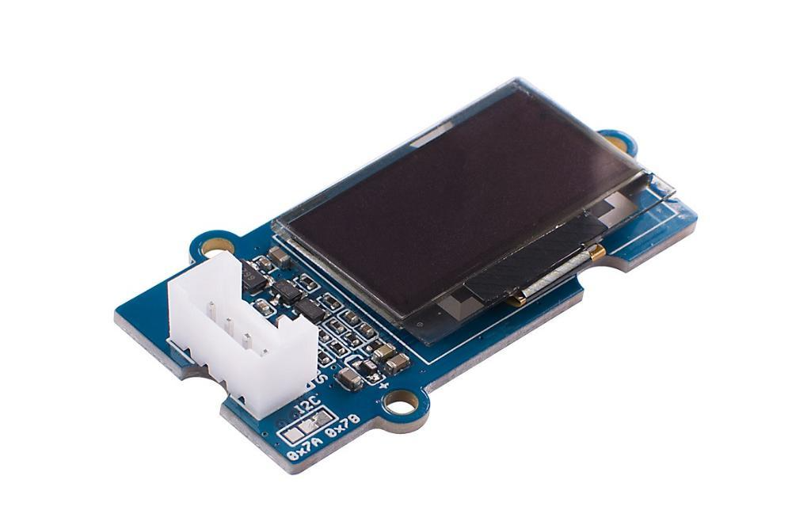
OLED DISPLAY
ARDUINO
OLED displays were used to serve as the eyes of the 3D printed face mask, adding a fun and interactive element to the attendance recording process. OLED stands for Organic Light Emitting Diode, which is a type of display technology that uses organic compounds to emit light when an electrical current is applied.
Arduino Uno was used to send signals to the OLED displays on the 3D printed face mask. The Arduino Uno is a popular microcontroller board that is widely used in the electronics industry for its ease of use, flexibility, and compatibility with a wide range of sensors and other components.

Slide 15
FACIAL RECOGNITION METHODOLOGY
Facial recognition is a biometric technology that identifies individuals based on their unique facial features.
Facial recognition technology works by capturing an image or a video of a person's face and then processing it to extract unique features like the distance between the eyes, the shape of the nose, and the curve of the lips. These features are then compared to a pre-existing database of facial images to identify the person.
Facial recognition technology is used in a variety of applications, including security, law enforcement, marketing, and personal identification. In the security sector, it is used for access control, surveillance, and to track individuals of interest.

Slide 16
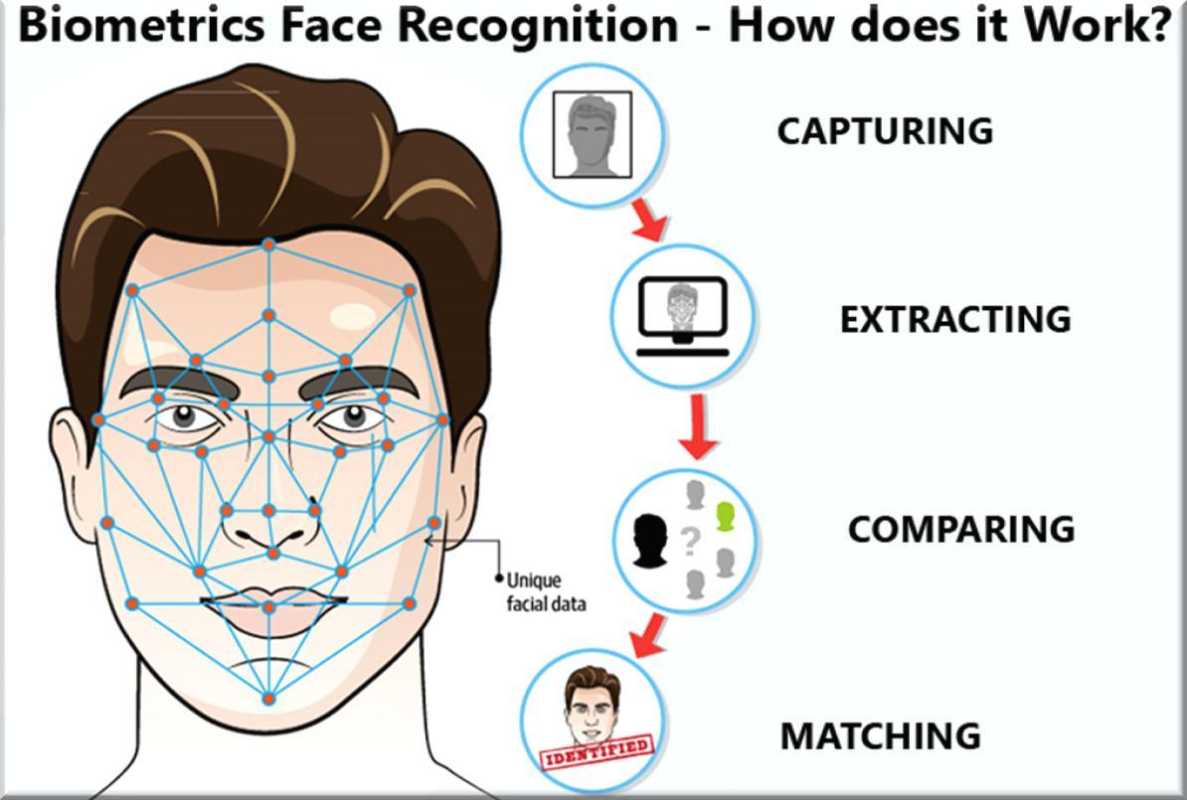

Slide 17
SOFTWARE IMPLEMENTATION
Arduino IDE
Visual Studio Code
Python
Libraries Used
Web Development

Slide 18
ARDUINO IDE
Arduino Integrated Development Environment (IDE) is a software application that is used to write, compile, and upload code to Arduino boards. It provides a user-friendly interface to the users for programming the Arduino boards. The Arduino IDE is an open-source software that is available for free to everyone. It supports various programming languages, including C and C++, and allows users to write code using a simple and intuitive syntax.
One of the main advantages of using the Arduino IDE is that it supports a wide range of Arduino boards, making it easy for users to choose the right board for their project.

Slide 19
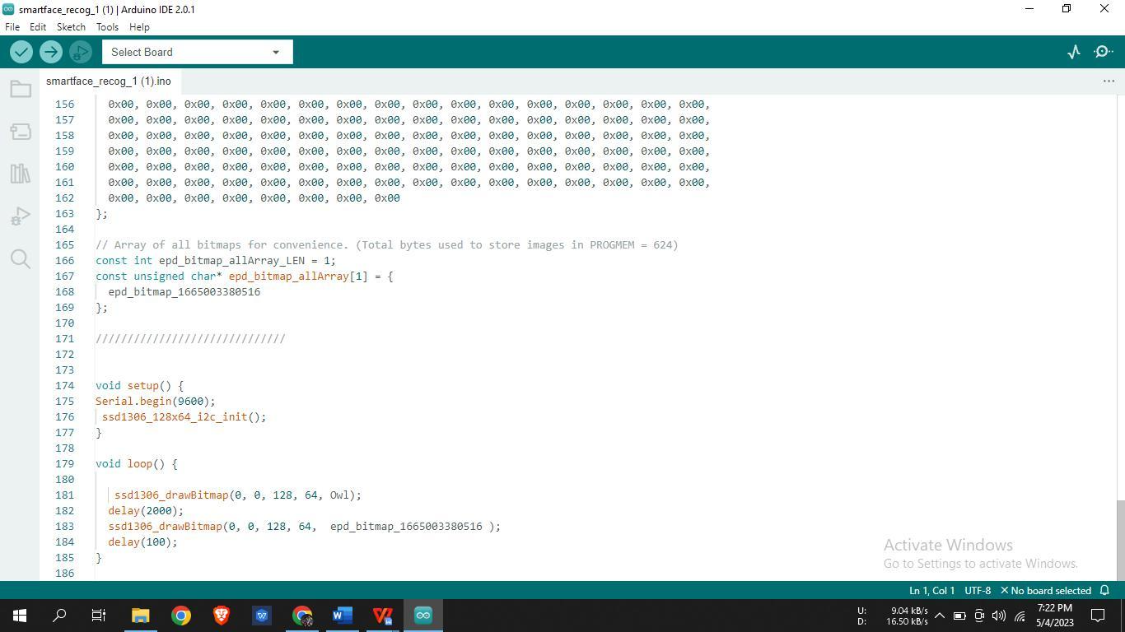

Slide 20
VISUAL STUDIO CODE
Visual Studio Code is a free and open-source code editor that is widely used by developers for building different types of software applications. In our project, Visual Studio Code is used as the primary code editor for writing and editing the Python code that runs on the Raspberry Pi.
Visual Studio Code offers many features that make it a popular choice for developers, such as a rich set of plugins, code completion, debugging tools, and source control integration. These features make it easier for developers to write and maintain high-quality code.
In our project, we use Visual Studio Code to write and debug Python code for our Raspberry Pi.

Slide 21
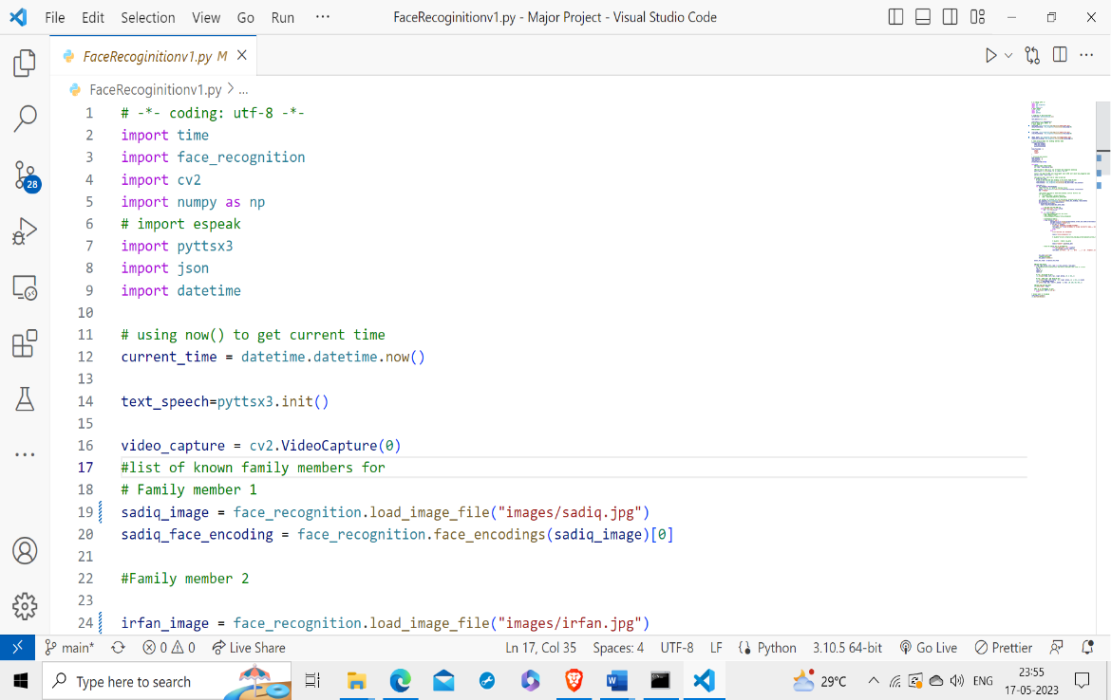

Slide 22
PYTHON
Python is a popular programming language used for facial recognition due to its simplicity, versatility, and vast collection of libraries.
It offers a wide range of tools for processing images and videos, making it an ideal choice for implementing facial recognition algorithms.
Python was chosen as the primary programming language due to its versatility, extensive libraries, and ease of use.
The face_recognition library in Python provides an easy-to-use interface for performing facial recognition tasks, such as detecting and recognizing faces in an image or video stream.

Slide 23
LIBRARIES USED
face_recognition
cv2
numpy
pyttsx3
date_time
time

Slide 24
WEB DEVELOPMENT
HTML
CSS
JavaScript
JSON
jQuery
Authentication
Data Visualisation
Node JS Backend

Slide 25
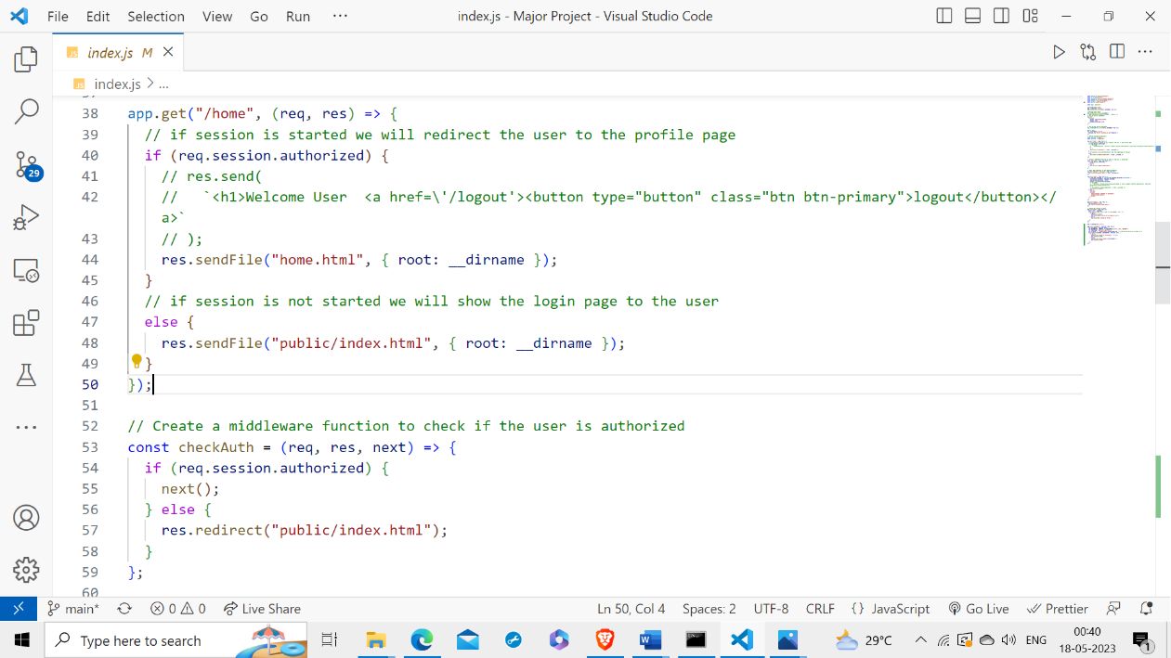
CODE FOR AUTHENTICATION

Slide 26
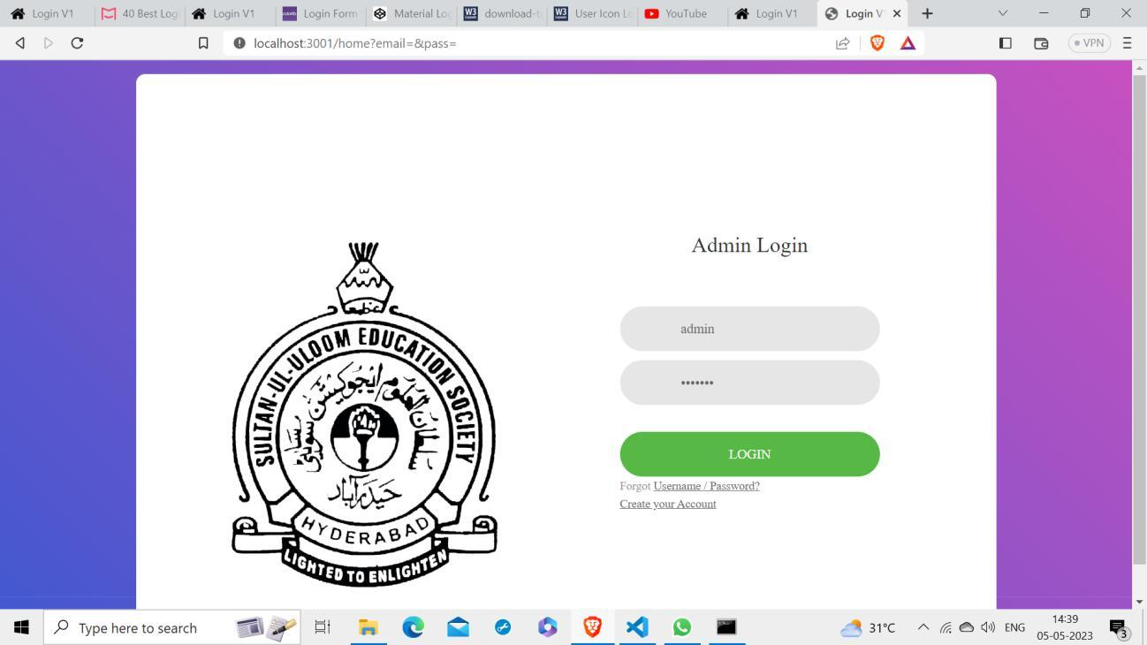
ADMIN LOGIN PAGE

Slide 27
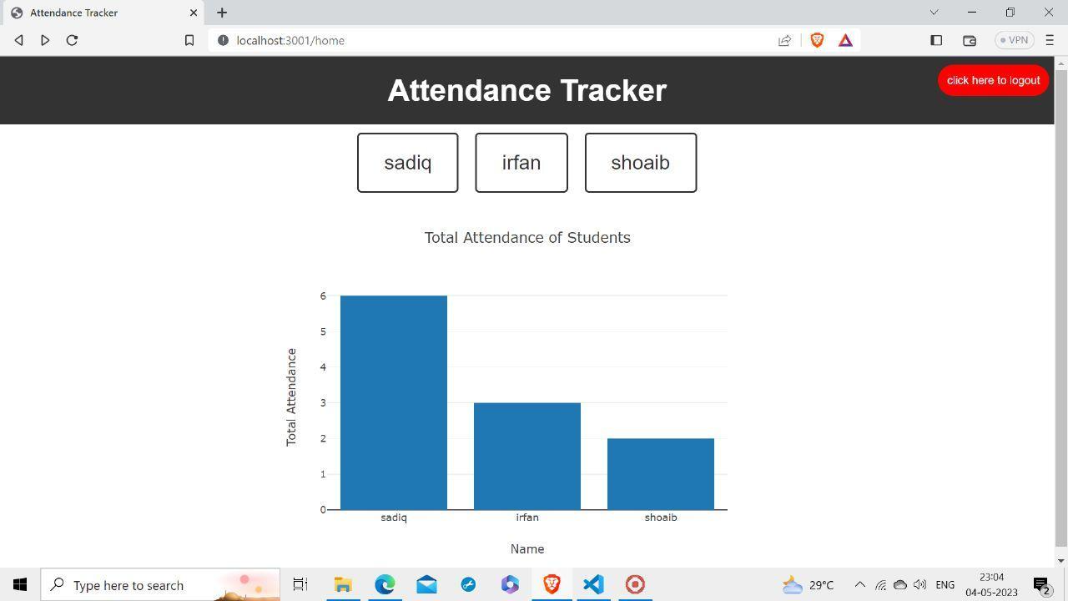
ATTENDANCE VISUALISATION

Slide 28
RESULTS
The output of a facial recognition-based attendance system would include the following:
Attendance records: The facial recognition-based attendance system will generate detailed records of the attendance for each student or employee. These records can be stored in a database or spreadsheet format, allowing for easy access and analysis.
Real-time status: The system will display the real-time status of attendance, providing information on the number of students present, absent, and late. This real-time status can be viewed on the web interface, giving teachers and administrators immediate visibility into the attendance situation.

Slide 29
Analytics: The system can provide visual analytics of attendance data in the form of graphs and charts. These visualizations help identify patterns and trends in attendance, allowing for better monitoring and analysis. For example, administrators can track attendance rates over time or identify specific days or periods with low attendance.
Verification: The system ensures the accuracy and reliability of attendance records by utilizing facial recognition technology. Each attendance entry is verified through the recognition algorithm, reducing the risk of errors or fraudulent entries. This verification process adds an additional layer of trust and credibility to the attendance data.
Efficiency: The facial recognition-based attendance system streamlines the attendance process, significantly reducing the need for manual tracking and recording. It eliminates the manual effort of taking attendance and minimizes the risk of errors associated with manual data entry. This increased efficiency saves time and resources for educational institution

Slide 30
Conclusion
The project successfully developed a robust facial recognition-based attendance system that automated the attendance-taking process in educational institutions. The implemented system incorporated various technical components and functionalities to achieve its objectives.
The facial recognition system utilized the webcam connected to the Raspberry Pi 4B for real-time face detection and recognition. Computer vision algorithms and libraries such as face_recognition and cv2 were employed to analyze facial features and accurately identify registered faces. The system displayed the names of recognized individuals on the OLED display, providing instant feedback during the attendance process.
The OLED display also showed the date and time, achieved through the DateTime library in Python, which retrieved and presented the current date and time information on the display. This feature enhanced the user experience by providing real-time information.

Slide 31
To improve user interaction, the system incorporated audio output and notifications. The pyttsx3 library in Python was used to convert text to speech, allowing the system to generate audio notifications for key events. Users received audible feedback upon successful face recognition and were alerted to any errors or exceptions that occurred during the attendance process.
The system efficiently stored information about recognized faces in a JSON file, serving as a database for attendance records. Python's JSON module facilitated the serialization and deserialization of data, enabling efficient management and analysis of attendance data.
A user-friendly web interface was developed using HTML, CSS, JavaScript, and jQuery. This interface allowed users to easily register new faces, view the list of registered faces, and perform operations such as record deletion. The responsive design of the web interface ensured accessibility across different devices, enhancing usability and customization.
Overall, the project successfully delivered an efficient and accurate facial recognition-based attendance system. The implemented technical components, including real-time face detection and recognition, the display of information on the OLED screen, audio notifications, data storage in a JSON file, and the user-friendly web interface, provided an effective solution for attendance management in educational institutions.

Slide 32
References
[1] Ojala et al. (1994) evaluated texture measures for classification based on Kullback discrimination of distributions. Their study focuses on the performance evaluation of texture-based features for distinguishing between different classes in image analysis tasks, offering valuable insights into potential feature extraction techniques for the project's face recognition algorithm.
[2] Ojala et al. (1996) performed a comparative study of texture measures for classification based on feature distributions. This research explores various texture descriptors and their applicability in image classification tasks, providing important knowledge for feature extraction and classification in the project's face recognition algorithm.
[3] Edwards et al. (1998) introduced active appearance models for interpreting face images. Their approach involves modeling the variations in facial appearance and shape to analyze and interpret facial images, serving as a crucial reference for understanding and implementing active appearance models in the project.

Slide 33
[4] Cootes et al. (1998) further expanded on active appearance models and their applications in interpreting face images. Their research focuses on modeling and analyzing facial variations using active shape and appearance models, providing additional insights and methodologies for the project's image interpretation component.
[5] Turk and Pentland (1991) proposed Eigenfaces for face recognition. This seminal work introduces the concept of eigenfaces, which are eigenvectors derived from principal component analysis, for efficient and effective face recognition. This reference is highly relevant to the project's face recognition algorithm design.
[6] Haider et al. (2014) conducted a comprehensive survey on face detection and recognition techniques. This study provides an overview of various methods and algorithms employed for face detection and recognition, offering valuable insights into the strengths and limitations of different approaches, which contributes to the project's understanding and selection of suitable techniques.

Slide 34
[7] Swets (1996) explored the utilization of discriminant eigenfeatures for image retrieval. This research focuses on using eigenfeatures derived from principal component analysis for efficient image retrieval tasks, providing valuable knowledge for the project's feature extraction and matching components.
[8] Paul and Al Sumam (2012) proposed face recognition using the principal component analysis (PCA) method. Their approach utilizes PCA to extract facial features and recognize individuals in face images, which aligns closely with the project's face recognition algorithm design.
[9] Dagher (2010) introduced an incremental PCA-LDA algorithm. This algorithm combines principal component analysis (PCA) and linear discriminant analysis (LDA) for feature extraction and classification tasks, providing a potential technique for enhancing the project's face recognition accuracy.

Slide 35
THANK YOU

